Slide 1


PYTHON PROJECT FOR HOTEL ACCOMMODATION

Slide 2
TEAM MEMBERS:-
TEAM LEADER:
PARTH GOYAL
2210992029
TEAM CO-LEADER:
PAHUL SHARMA
2210992010
TEAM MEMBER:
PARMANAND THAKUR
2210992024

Slide 3
APPROVED BY:-
Dr. AMANDEEP KAUR
A mentor is someone who sees more talent and ability within you , than you see in yourself and helps to bring it out of you.

Slide 4
INTRODUCTION :-
We have tried our best to simplify the complicated process of Web-Based hotel accommodation. and in this process we got the help of a computer programming language and that was ‘PYTHON’.

Slide 5
Utility of the software:
By using this software a person can:
Book rooms in a Hotel.
Extract information about the rooms available and the cost of each room.
The information about the restraunt and its menu can also be accessed through this software.
Payments can be made with a lot of options .
A person can also check his record i.e.,for how many days the person stayed there and the utilities that were used and the eatables that were ordered from the restraunt.

Slide 6
HOW THE SOFTWARE WORKS(Technically):
First of all , whole code can be accessed using six numbers (0,1,2,3,4,5).
By pressing number ‘1’ , a person can book a room.
Number ‘2’ will be used to access the information about different types of rooms available in the hotel and the cost of each room can also be inferred by pressing ‘2’ .
The number ‘3’ would let the customers access the menu card of the hotel restraint.
Number ‘4’ will provide four payment options.
Number ‘5’ will print a record or the bill .
Number ‘0’ would be used to either go back in the program or exit from the program.

Slide 7
How the software will look like to the customers:
Firstly the customer will be asked the his/her name, phone number and address.
Then the check-in and check-out date would be asked .
Once the above mentioned details are provided by the customer , he/she will be able to get information about the types of rooms available in the hotel and the cost of each room.
When the room is booked , Room no. and customer id would be provided to the customer .
Then the user will be able to to use the room services and order anything from the hotel restraint’s menu.
Before checking-out , the user will get 4 options to pay for the room and the items ordered.

Slide 8
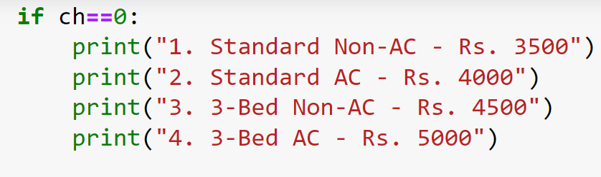
4 types of rooms available in the Hotel:

Slide 9
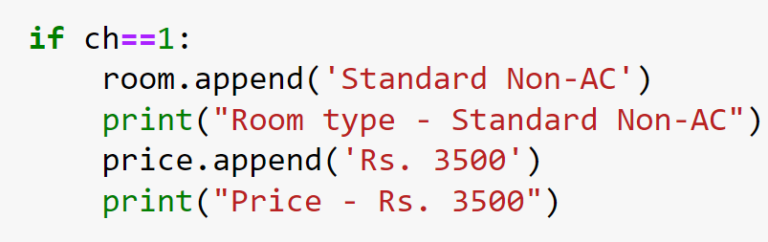
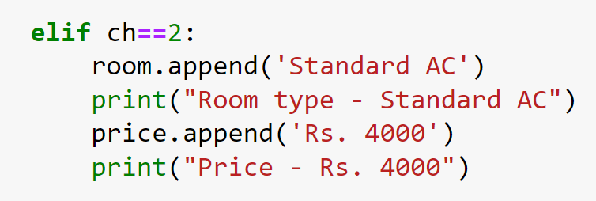
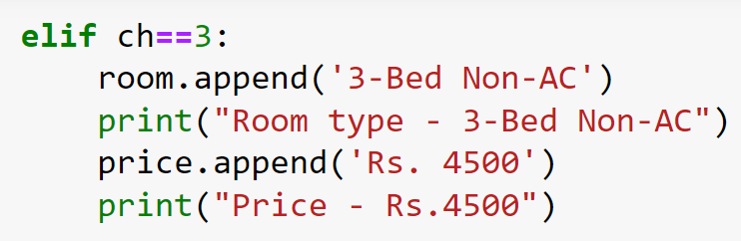
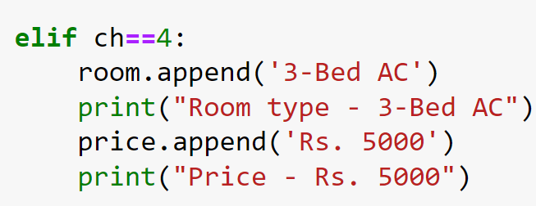
Descirption of each room in the Hotel:

Slide 10
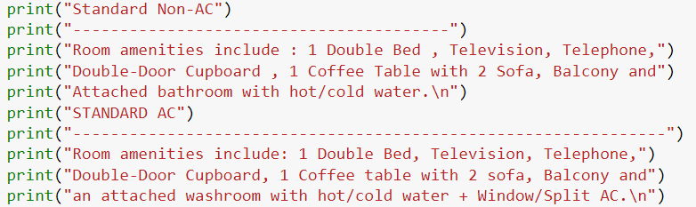
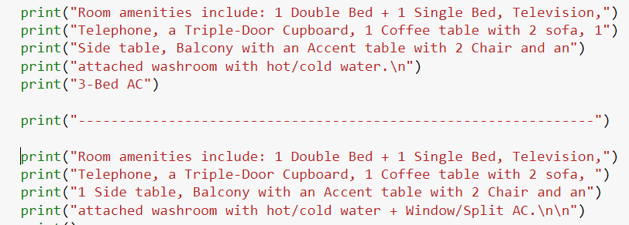
Detailed description of the rooms:

Slide 11
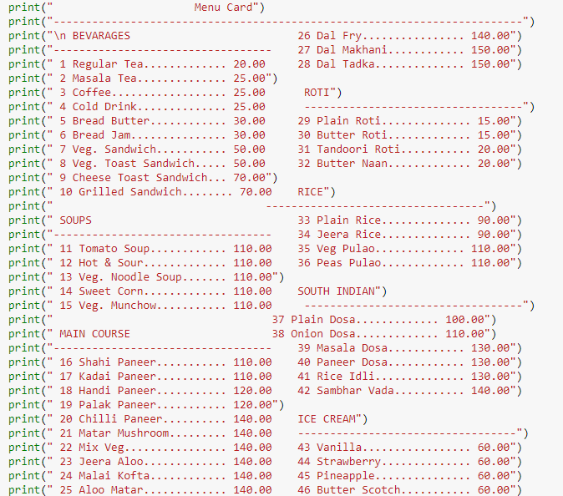
Menu card :

Slide 12
At the end the only thing that can be mentioned is that without the teamwork and guidance of our mentor the simplification of the web based hotel accommodation process could not be possible .

Slide 13

